Slide 1

G2M Cab Investment Insight
Virtual Internship
07-16-2024
By Nuzat Siddiqua

Slide 2
Buisness Problem:
XYZ, a private firm in the US, is considering investing in the cab industry, which has seen significant growth and has multiple key players. XYZ requires a detailed analysis of market trends, customer profiles, and transaction data to identify the best investment opportunity between two cab companies.

Slide 3
Objective
To provide XYZ with actionable insights and a comprehensive analysis of two cab companies to identify the optimal investment opportunity. The analysis aims to understand market trends, customer profiles, and transaction patterns, ultimately helping XYZ make an informed decision about their investment in the cab industry.

Slide 4
Approach
Identify the correlation between cost of trip, km travelled and profit & user and population.
Conducted a year-over-year comparison to highlight growth or decline in profits.
Analyzed cab usage patterns to determine the demand difference between weekdays and weekends.
Analyzing the age group of user’s usage preference of cab service
Analyzing the user’s cab usage based on thier income and age
Analyzing the profit trends of both companies, average cost of trip & price charged.
Understanding the usage and demands of cabs in various top cities and the profit margin in different cities
Check for any prefered payment method

Slide 5
Data Overview
Data Provided:
Cab_Data.csv: Transaction details for two cab companies.
Customer_ID.csv: Mapping table for customer demographics.
Transaction_ID.csv: Mapping table for transaction and payment mode.
City.csv: US cities with population and number of cab users.
Assumption:
Time frame of the data is 2016-2018
4 of the .csv files were merged; create a final_df master dataset.
Price Charged and Cost of Trip features used to calculate profit.
Outliers are present in Price Charged feature but due to
unavailability of trip duration details ,we are not treating this as outlier.
Date of travel was changed to real date from excel series
Year, month, day, number of rides were extracted as different features

Slide 6
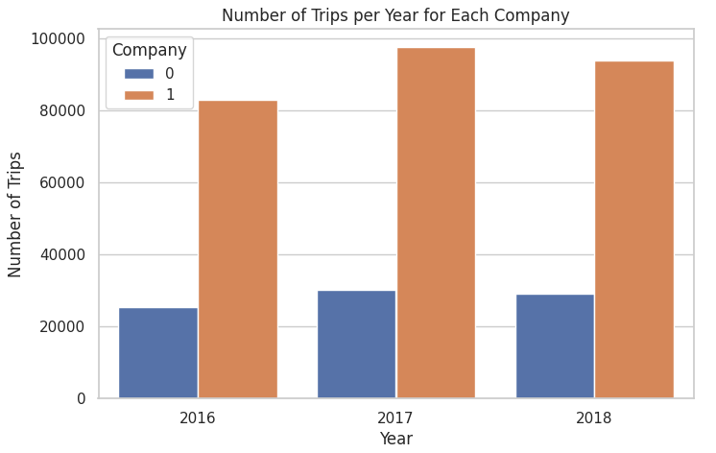
EDA & Hypothesis
Customer prefer yellow cab over pink cab. {0: pink cab; 1: yellow cab)

Slide 7
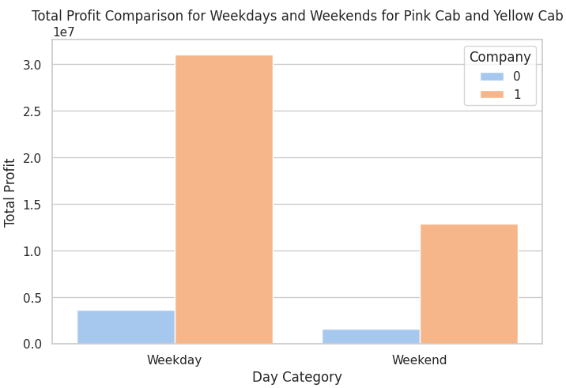
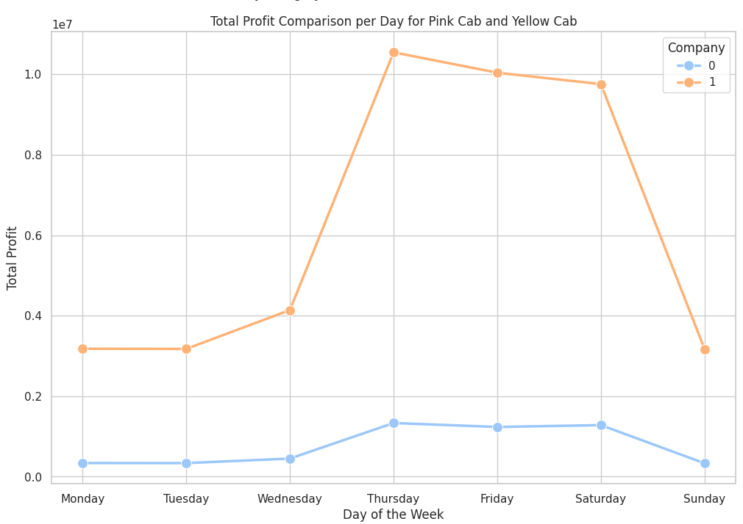
EDA & Hypothesis
The demand for cab increases on weekdays specially thursday & friday. The demand for cab in weekend is also high only on Saturday.
In terms of days the profit margin pink cab profit margin doesn’t fluctuate as much as yellow cab which means the number of rides almost same for pink cab. Their demands remains same.

Slide 8
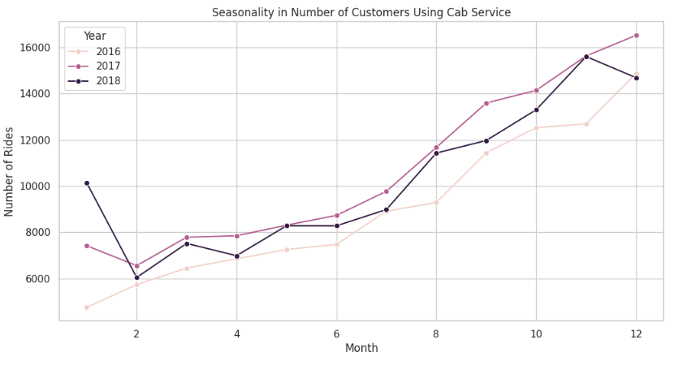
EDA & Hypothesis
The line graph shows seasonality in the number of customers using the cab service. There are peaks in the spring and summer months (around months 4-6 and 8-11) and dips in the fall and winter months (around months 12 and 2).

Slide 9
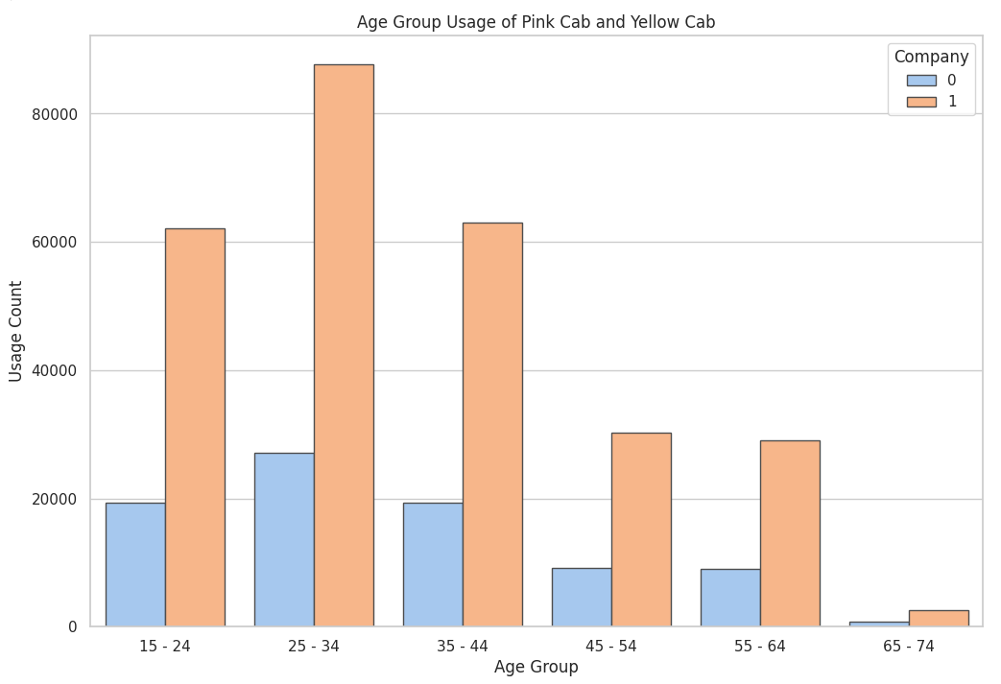
EDA & Hypothesis
The age group of 25-35 range people are the highest user of cab. They are spending most money on cab services.

Slide 10
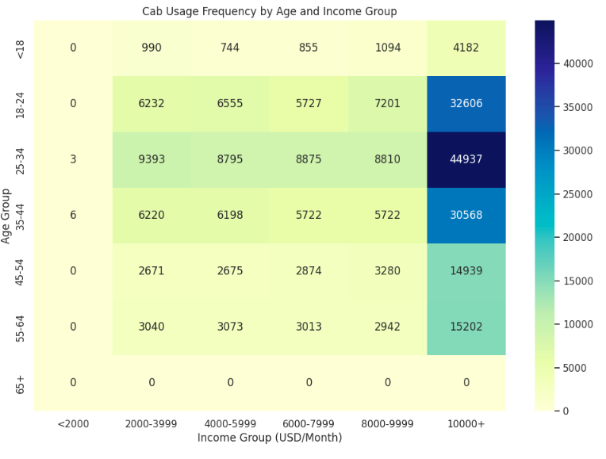
EDA & Hypothesis
The analysis also showed that the age group of 25-34 people who earned more than 10000 use cab most frequently.

Slide 11
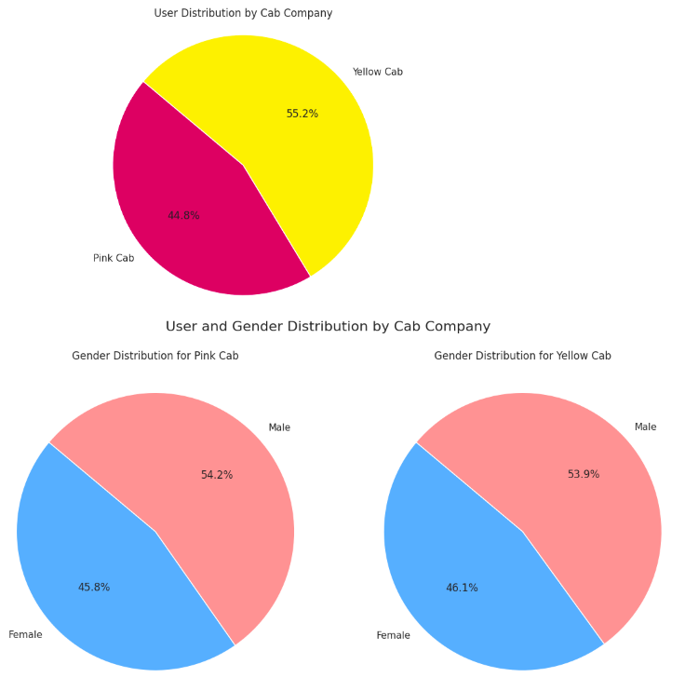
EDA & Hypothesis
The highest number of users of cab services in both companies are man.
All type of customer pre prefer yellow cab than pink cab more.

Slide 12
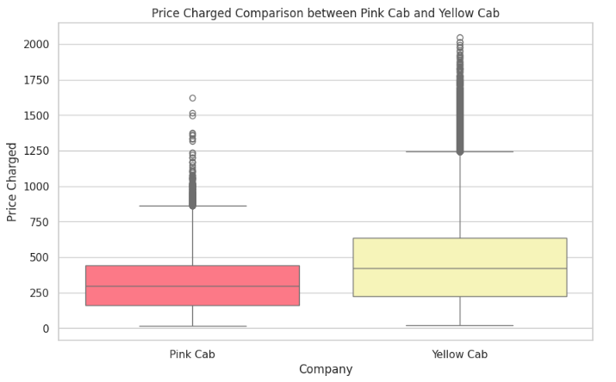
EDA & Hypothesis
In terms of Price charge of cab companies, yellow cab is charging people more money than pink cab.

Slide 13
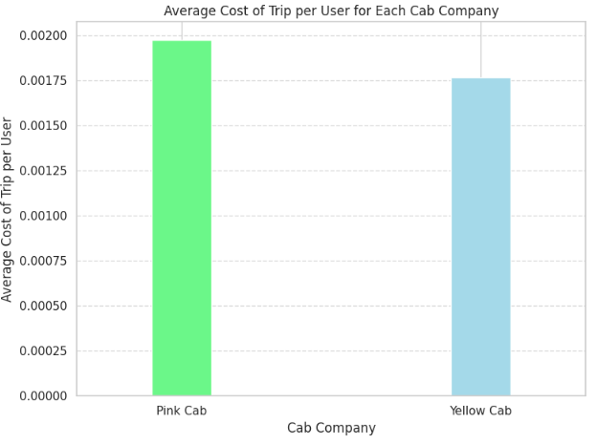
EDA & Hypothesis
The analysis shows that avaerage trip cost per user of pink cab cost more than yellow cab.

Slide 14
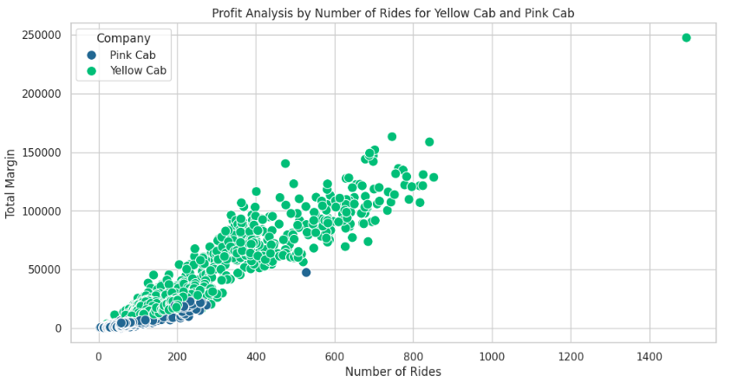
EDA & Hypothesis
The total profit, however, is not proportional to the number of rides.
However the profit margin increases as the number of rides increases

Slide 15
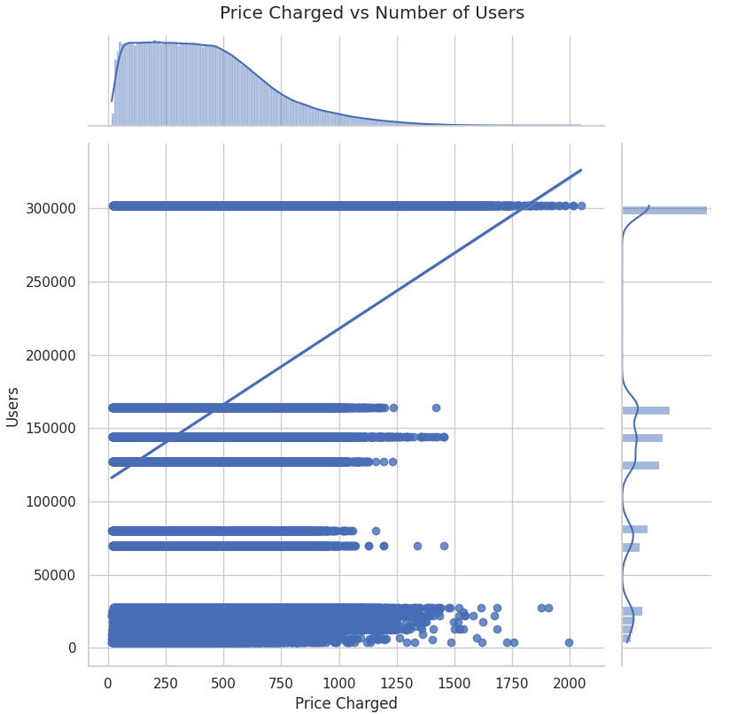
EDA & Hypothesis
Some customers are price sensitive, with increase of price charged their demand is decreasing. But there are stable number of users despite price increases those users are less price sensitive and value the service enough to be willing to pay a higher price.

Slide 16
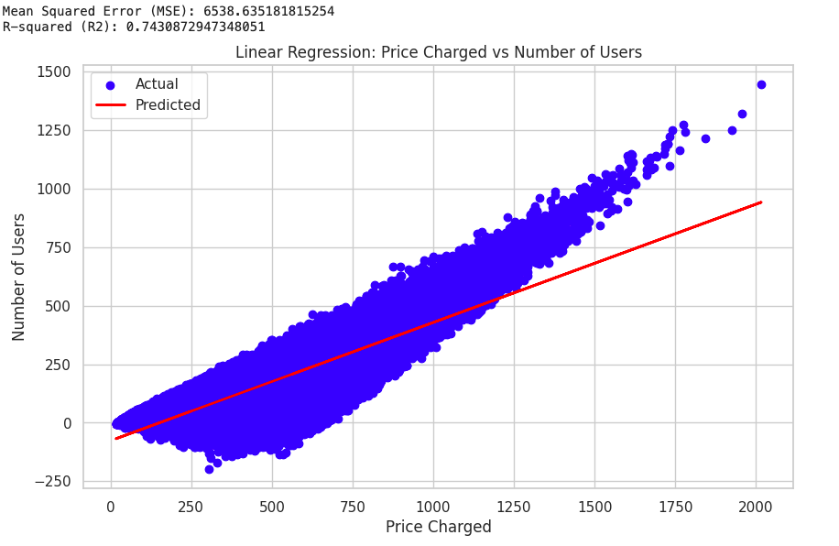
EDA & Hypothesis
Some companies appear to be more profitable at higher prices (upper right corner), while others seem to be profitable at lower prices (lower right corner).
This suggests that the effect of price on profitability can vary depending on the company. Companies with lower cost of trips (yellow cab) can be profitable even at lower prices.

Slide 17
Recommendations
1. Even though yellow cabs charge more than pink cabs, customers prefer yellow cabs. Some customer are willing to pay more if they get best services. Keeping all of these in mind XYZ companies has to invest.
2. Sometimes customer are price sensitive with increase of price charge their demand decreases. Cab companies with lower cost of trips (yellow cab) can be profitable even at lower prices. Yellow cab has lower average cost of trip than pink cabs. As a result, yellow cabs make the highest profit margins.
3. People aged 18 to 35 prefer to use cabs. The majority of them prefer yellow taxis. As the number of rides increases, so does the profit and utilization.
4. Seasonality is one more thing that has to be considered in the buisness to ensure of availability of service. Analysis shows customers especially demand cabs during the summer and spring.

Slide 18
Recommendations
5. The demands for cab and usage of cab defer in different cities. The busiest and populous cities uses cab services more than the small cities. So ensuring availibility according to the demand of cities can be a strategic move to ensure highest profitibility. And analysis suggests even in the most populous cities, yellow cabs outnumber pink cabs in terms of journeys and users.
6. Payment really doent impact too much on cab usage or profitibility as both companies are using card and cash both. customers also using both type of transaction.
7. Gender also desnt have much impacting on the buisness. Both male female are using cabs.
Analysis indicates that Yellow Cab is the best firm for XYZ to invest in.

Slide 19
Thank You

